Slide 1
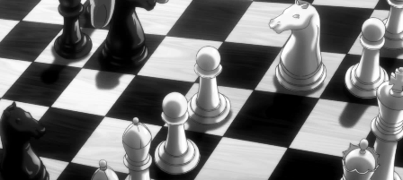
Data science project Chess game
Hila Matok

Slide 2
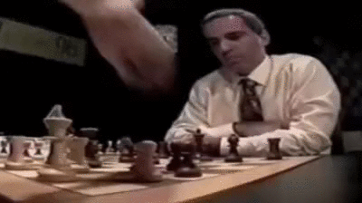
About Chess
A board game played by 2 people
Each player controls an army of 16 pieces
One army is black and the second white
Each piece moves in a unique manner
A game of strategy and concertation

Slide 3
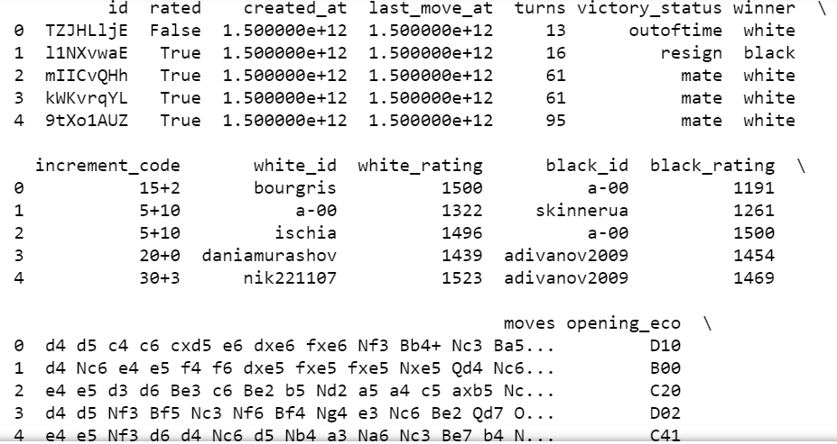
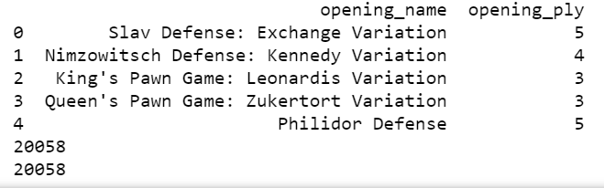
We can see the csv file that represents all the data collected, the player's name, the number of moves made in the game, what status the game ended, who won the game, the ranking of players playing, tracking players' steps, opening type and more.

Slide 4
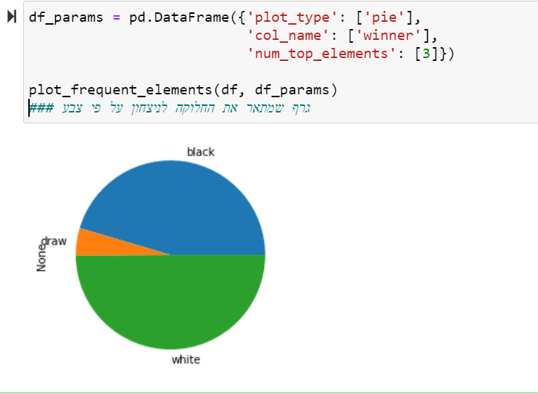

Slide 5
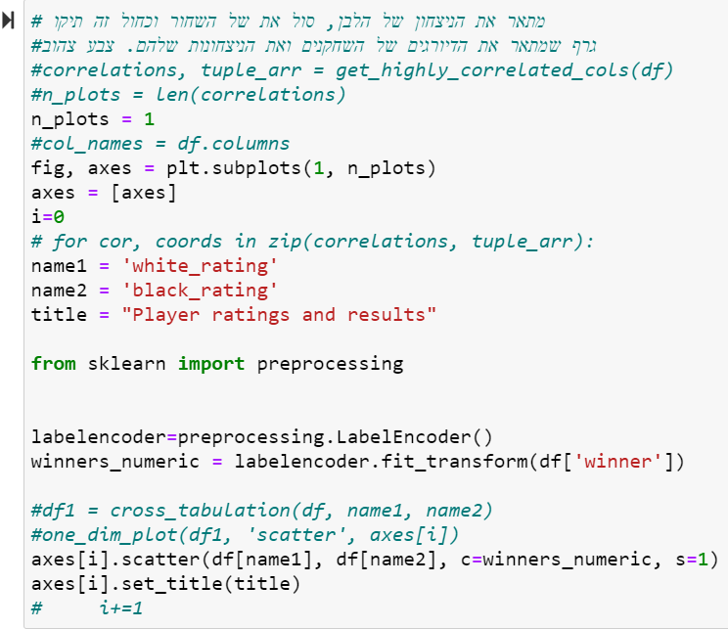
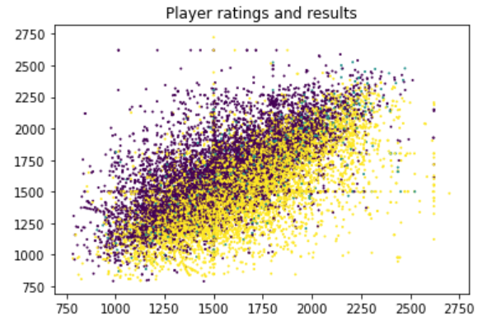

Slide 6
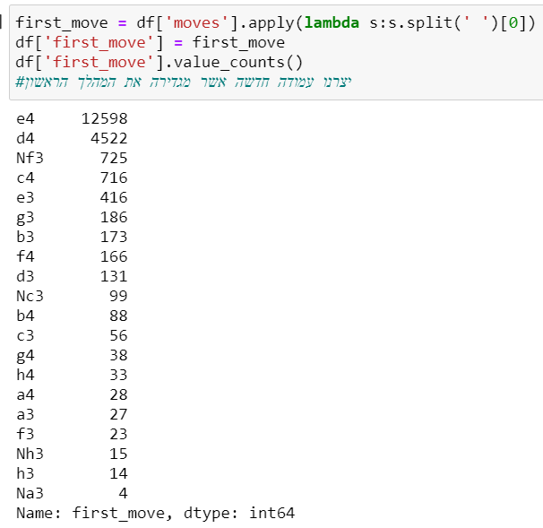
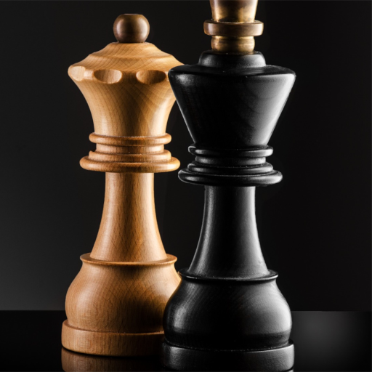

Slide 7
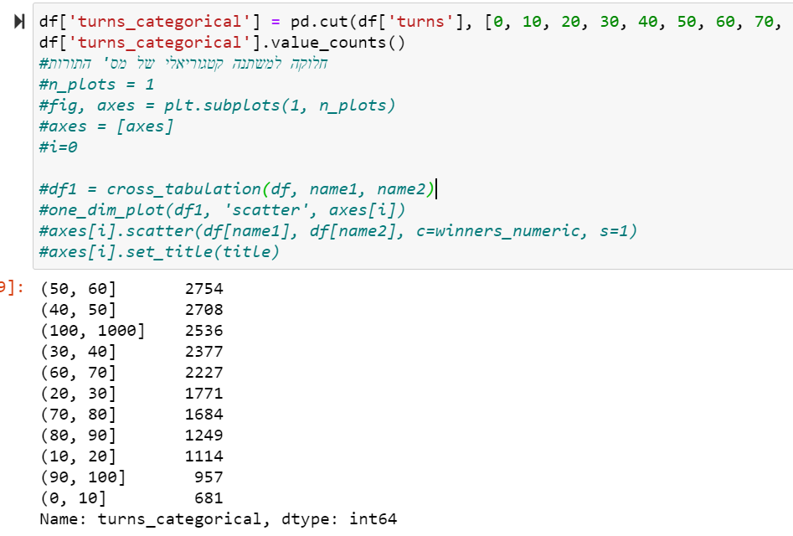
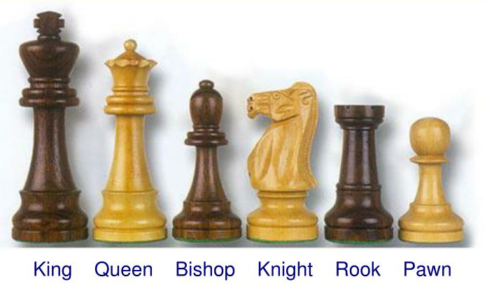
The purpose of the turns_categorial function is to divide the ranges by the number of steps performed in the game. I will make the division in jumps of 10, everything over 100 will be concentrated in one column.

Slide 8
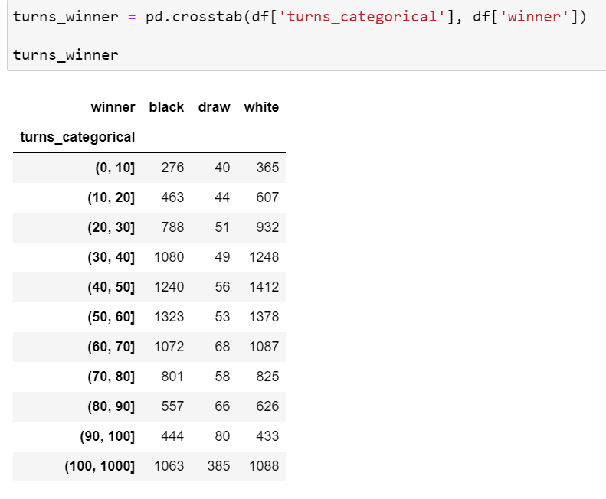
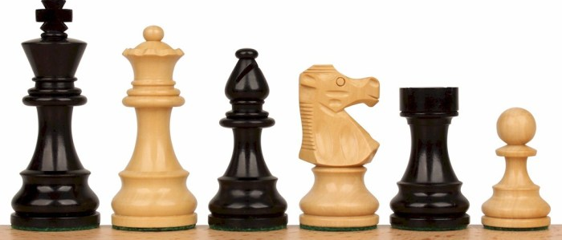
The purpose of turns_winner function is to perform crosstabulation between the range of steps and victory. It is important to note that in the beginning when the number of steps is small the profit will be for the white player.

Slide 9
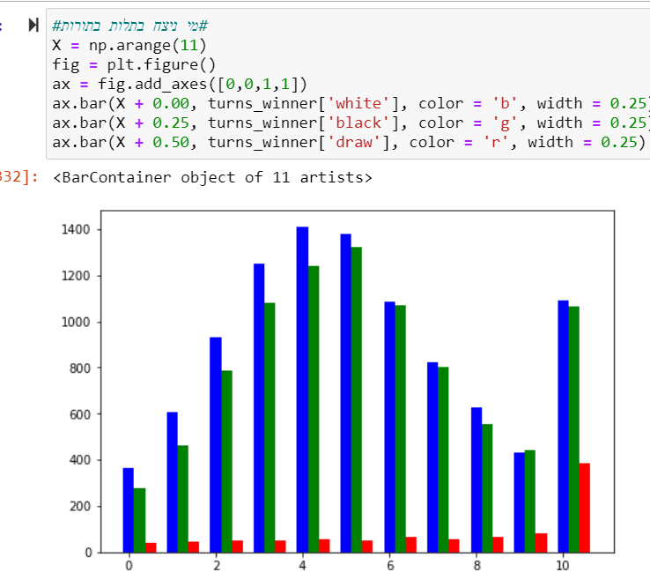
The graph describes the categories we have (11 in total)
The graph shows 11 columns, each with 3 colors - green, red and blue.
Green color - describes a victory for the black player.
Blue color - describes a victory for the white player.
Red color - describes that the game ends in a draw.
ציר X מייצג את כמות המשחקים.
ציר Y מייצג קטגוריות של מספר הצעדים= טווחים.

Slide 10
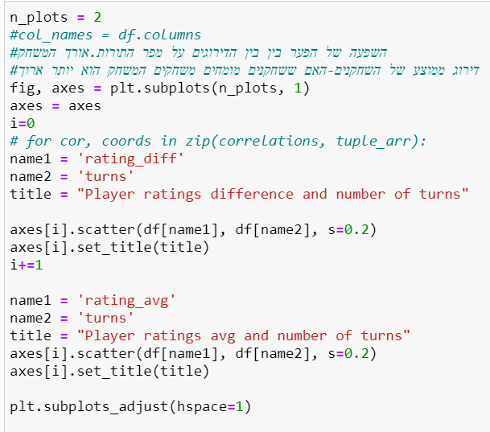
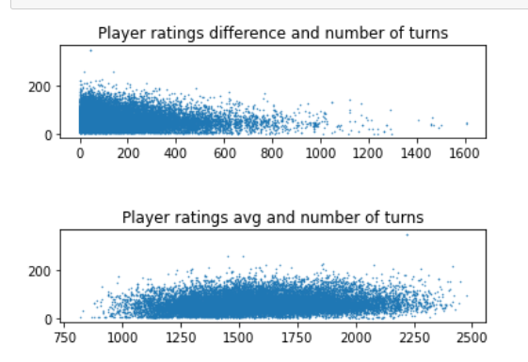
The attached graphs show several conclusions
1. If the players have the same rating or their rating is close, then the number of steps of the players will be greater.
2. If the players have the same rating or their rating is close then the game is longer.

Slide 11
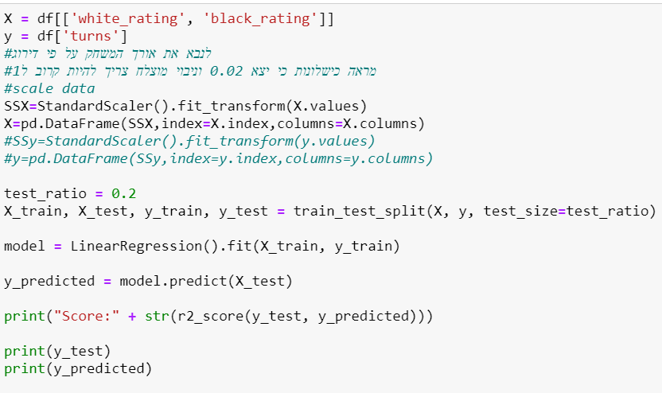
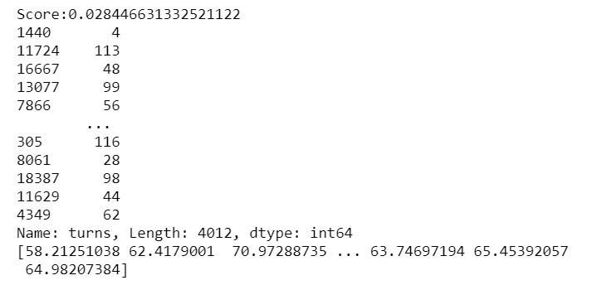
ניסיון לנבא את אורך המשחק ע"פ דירוג השחקנים

Slide 12
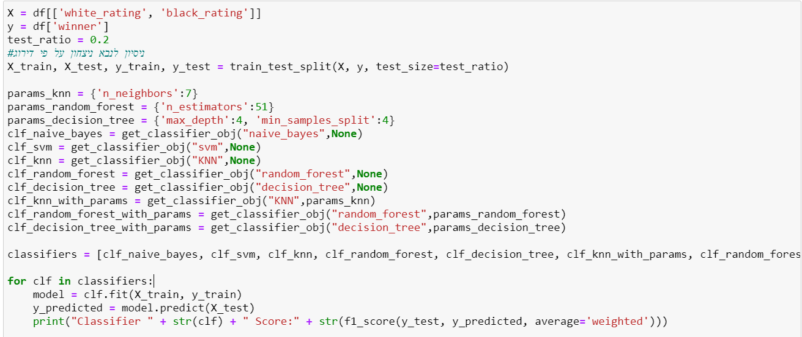
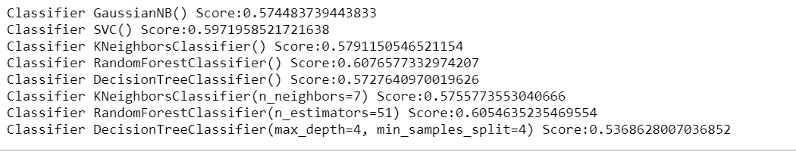
ניסיון לנבא ניצחון במשחק ע"פ דירוג

Slide 13
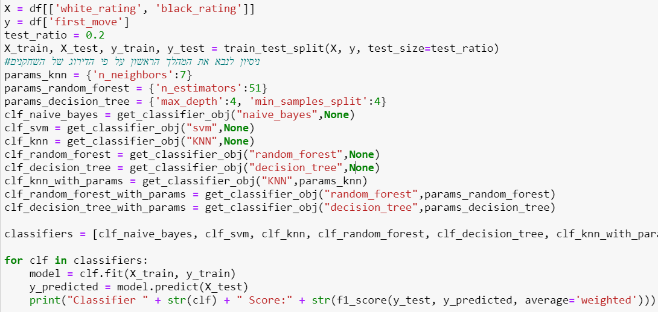
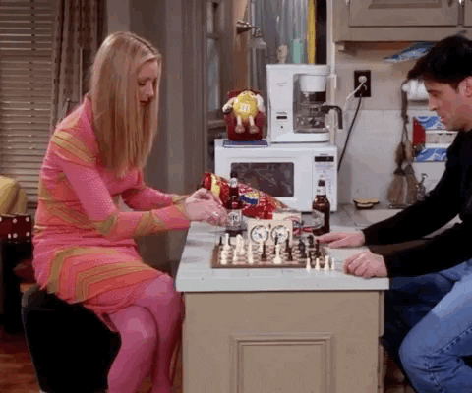
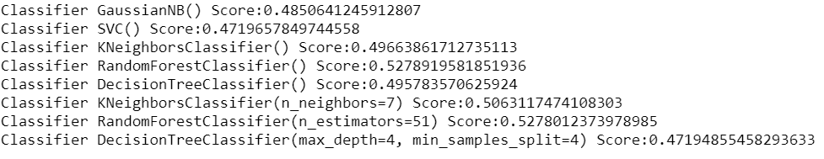
ניסיון לנבא ניצחון במשחק ע"פ הצעד הראשון

Slide 14
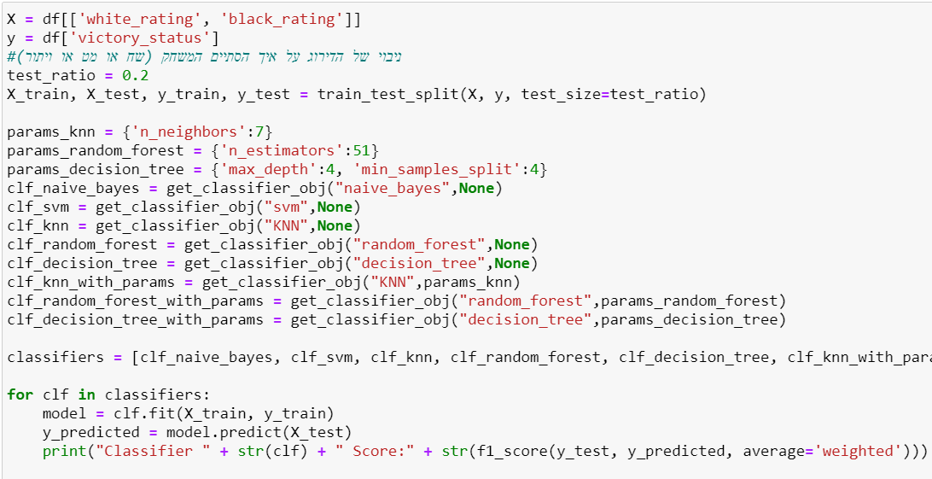
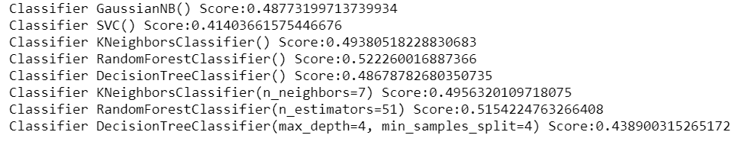
ניסיון לנבא באיזה אופן יסתיים המשחק ע"פ דירוג השחקנים

Slide 15

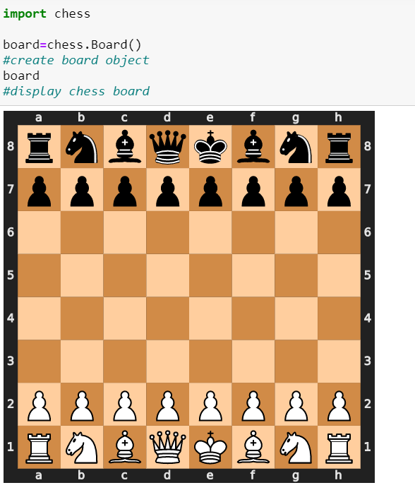
WOW

